Slide 1

Software Design and architecture (SE322) gg
Week 06
Said Nabi
said.nabi@giki.edu.pk
Faculty of Computer Science and engineering
Gik Institute Topi, Swabi

Slide 2
List of Topics
Design patterns ( Creational, Structural, Behavioral)

Slide 3
Façade Design Pattern (Structural)
As systems grow larger, they often become more complex. The Façade Design Pattern helps manage this complexity by providing a single, simplified interface for client classes to interact with a subsystem.
A façade acts as a wrapper class, hiding the subsystem’s internal complexity without adding new functionality, much like a waiter who simplifies the process of ordering food.
This pattern is useful when:
  Client interaction with a subsystem needs to be simplified.
  A class needs to create and provide instances of other classes.

Slide 4
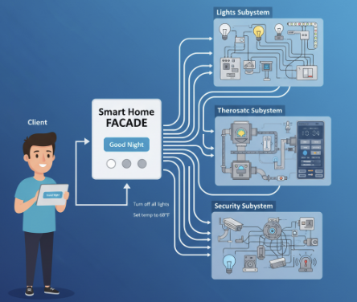
Example
The Smart Home Controller is the Facade class. It stands between the complex subsystems and the client.
Simplification:
The Facade exposes a single, high-level method, like goodNight().
Delegation: When the Client calls goodNight() on the Facade, the Facade does all the heavy lifting behind the scenes. It knows exactly which calls to make to the complex subsystems.

Slide 5
Example Cont…
Often façade design pattern combines interface implementation by one or more classes, which then gets wrapped by the façade class.
This can be explained through a number of steps.
    1. Design the interface.
    2. Implement the interface with one or more classes.
    3. Create the façade class and wrap the classes that
    implement the interface.
    4. Use the façade class to access the subsystem.

Slide 6
Example Cont…
Bank Service
User
<<interface>>
Account
Click To See Java Code
Chequing
Saving
Current

Slide 7
Pros
Hides the complexity of a subsystem by encapsulating it behind a unifying wrapper called a façade class.
Removes the need for client classes to manage a subsystem on their own, which results in less coupling between the subsystem and the client classes.
Handles instantiation and redirection of tasks to the appropriate class within the subsystem.
Provides client classes with a simplified interface for then subsystem.
Acts simply as a point of entry to a subsystem and does not add more functional subsystems.

Slide 8
Cons…
Facade may not expose the full functionality of the underlying subsystem limiting flexibility for users who need fine-grained control or access to more advanced features hidden behind the abstraction.
Overusing the facade pattern can lead to a large and bloated facade class that tries to do too much, which can make the facade as complex as the system it was intended to simplify, thereby defeating its original purpose.
In rapidly changing systems, maintaining a facade can become burdensome, as the facade must be updated in step with changes in the subsystem to avoid becoming outdated or mismatched with the internal logic.

Slide 9
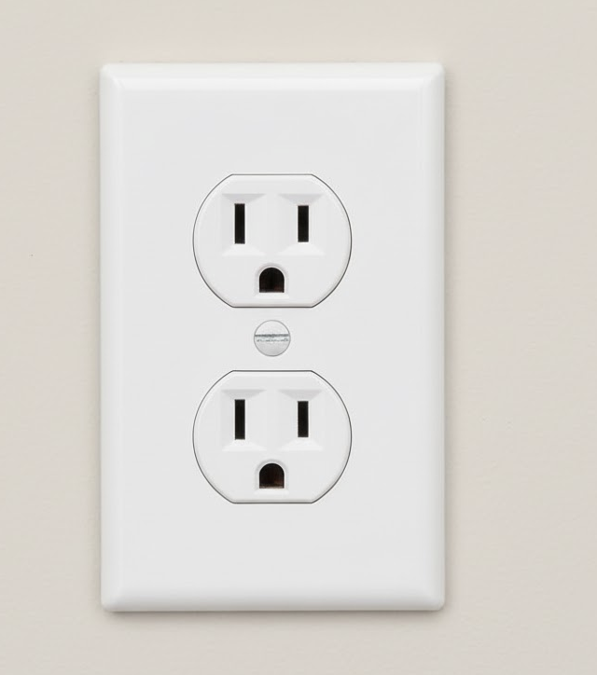
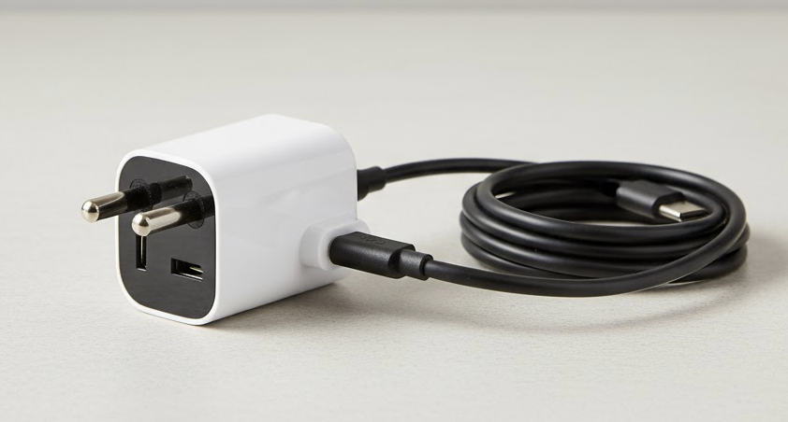
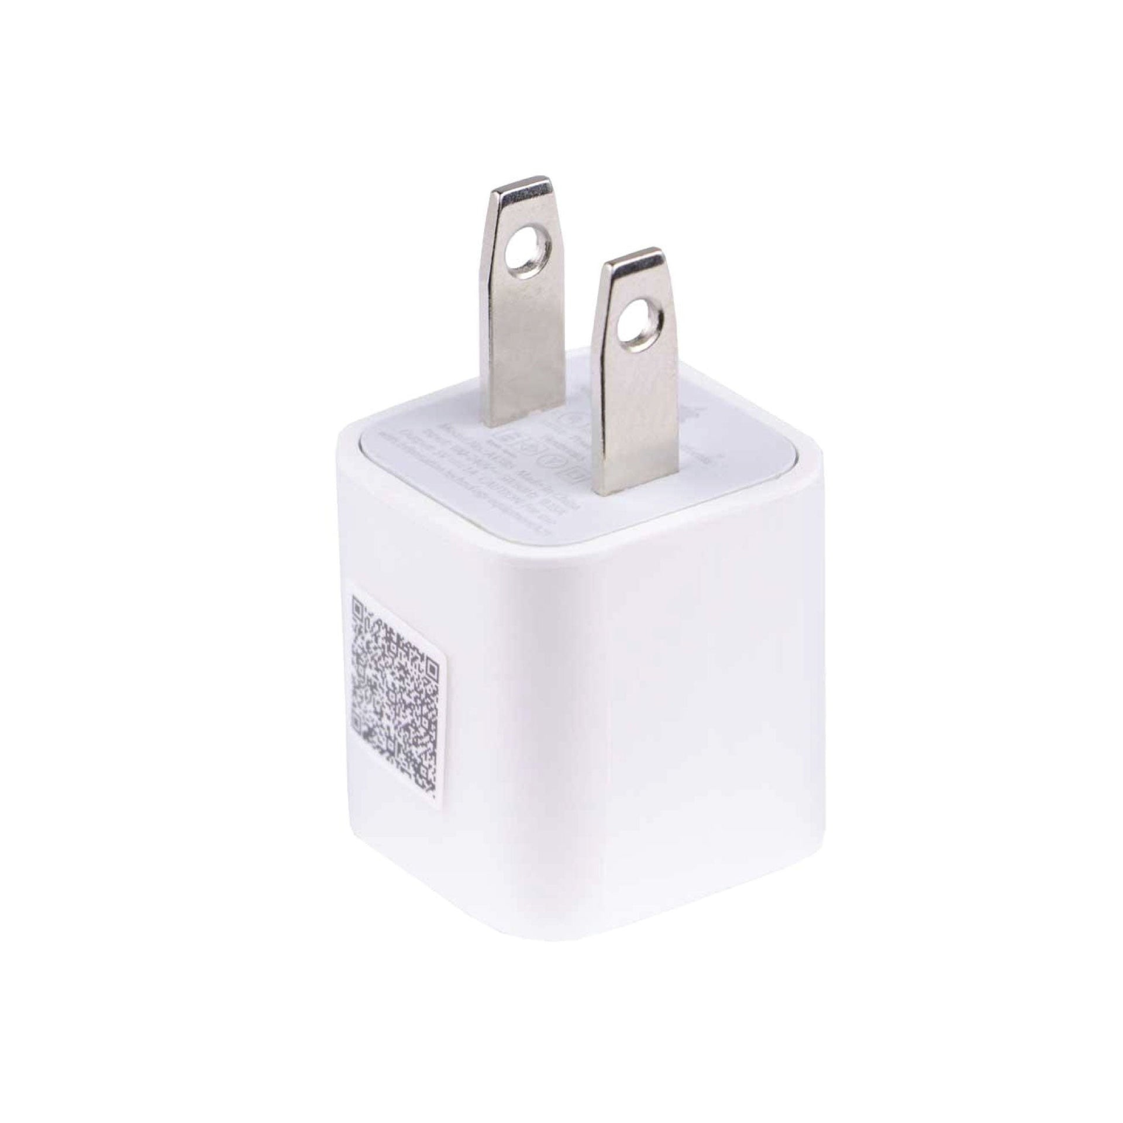
Adapter Pattern:

Slide 10
Adapter Pattern Cont…
Physically, an adapter is a device that is used to connect pieces of equipment that cannot be connected directly.
Not all systems have compatible software interfaces.
    The output of one system may not conform to the expected input of another system.
The Adapter design pattern is a structural pattern used when an existing system needs to work with third-party libraries or connect to other systems.
It acts as a bridge, providing a compatible interface that enables communication between two otherwise incompatible systems.

Slide 11
UML Diagram
Target
Interface
Request
Translated Request
Adaptee
Client
Adapter
Click To See Java Code

Slide 12
Adapter Pattern Cont…
The adapter design pattern consists of several parts.
Client Class – This is the part of your system that wants to use a third-party library or external system.
Adaptee Class – This represents the external system or third-party library that needs to be integrated.
Target Interface – This defines the expected communication format for the client.
Adapter Class – This sits between the client and the adaptee. It implements the target interface, translates the client’s requests into a form the adaptee understands, and forwards them accordingly.

Slide 13
Thank You☺

